Slide 1
ACKNOWLEDGEMENT
The photographs used in this presentation are courtesy of geograph.co.uk, and are re-used here under the Creative Commons Licence. Thanks to individual photographers, who are credited under their work.

Slide 2
CREATIVE SPACES
What does an artist of any kind require in order to produce art – visual or written?

Slide 3
For creative people of all kinds, having a space in which to work is very important.
Dylan Thomas’s work space was above the Taf estuary in Laugharne, west Wales, which inspired much of the imagery in his poems...
‘the heron-priested shore’.

Slide 4
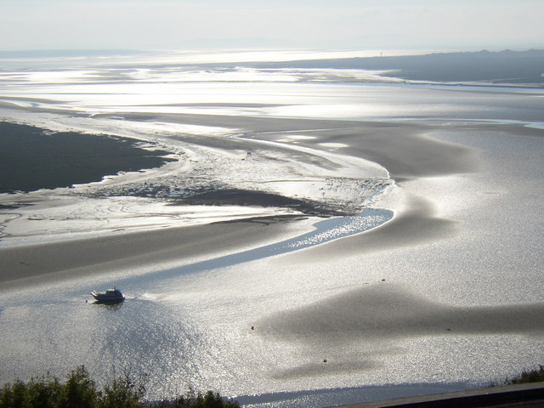
Humphrey Bolton http://www.geograph.org.uk/photo/579531

Slide 5
The light, the sounds, the movement, the wind, the waves and the patterns of the sea all made their way into writings such as Under Milk Wood –
‘the sloeblack, slow, black, crowblack, slowblack, fishingboat-bobbing sea...’

Slide 6
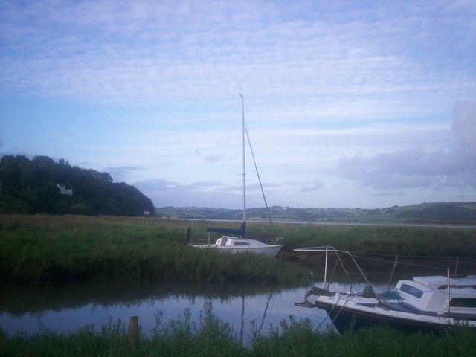
Welshbabe http://www.geograph.org.uk/photo/3611376

Slide 7
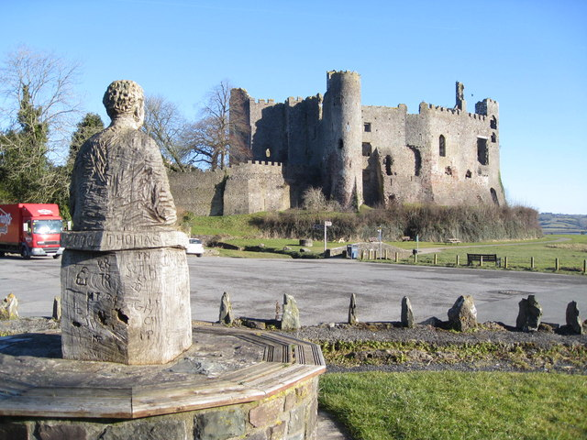
Colin Vosper http://www.geograph.org.uk/photo/1708250
The famous Boat House where Dylan lived with his wife,Caitlin,and their three children lies around the corner of this path, skirting around the base of Laugharne castle, solitary above the estuary.

Slide 8
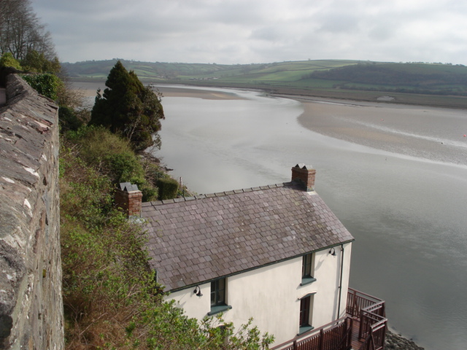
Trevor Rickard http://www.geograph.org.uk/photo/461239
The Boat House itself seems to hover above the water, looking out over the changing, moving sands, offering a place of calm and inspiration in the midst of his turbulent married life.

Slide 9
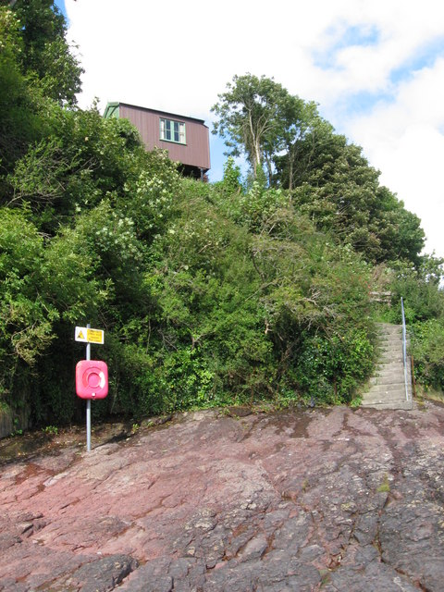
The writing shed was the garage which stands on the lane above the Boat House...a wooden shed, which seems to balance on the cliff top, precarious and safe at the same time.
Gareth James http://www.geograph.org.uk/photo/2056773

Slide 10
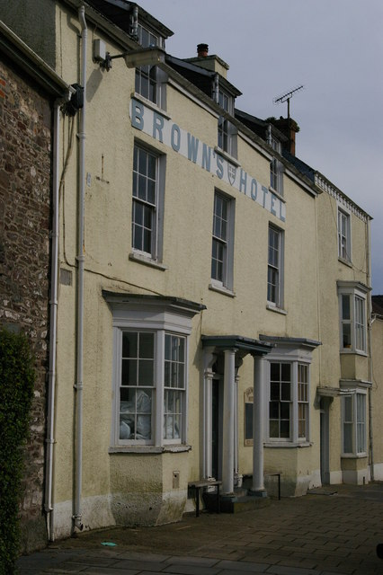
Christopher Hilton http://www.geograph.org.uk/photo/2236959
Some people cannot work in silence and need the stimulating company of others to provide them with ideas and material for their work.
Perhaps Browns where Dylan Thomas went to drink and chat with the people of the village, was in its way a creative space of a different kind.

Slide 11
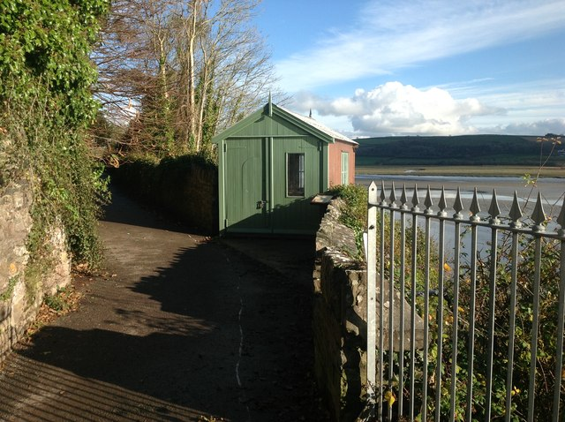
Lynn Mathews http://www.geograph.org.uk/photo/3273805
But the shed was a haven which allowed Dylan to be locked in, and the world to be locked out. It is a small space for large creative ideas to be born and to grow.

Slide 12
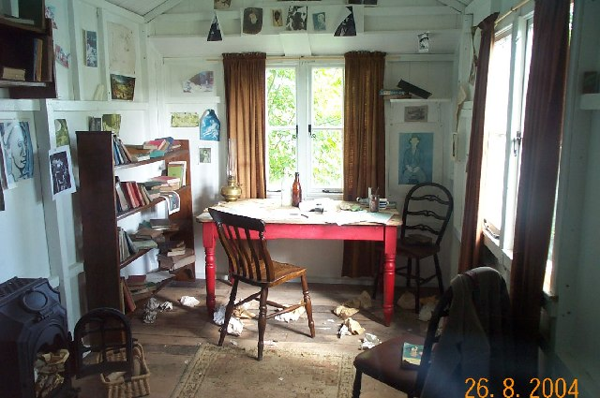
Richard Knights http://www.geograph.org.uk/photo/15855
The inside is kept as it was, complete with scraps of paper and half worked writings, refreshment on the table, a flung coat and piled up books. Creative chaos.

